Slide 1



K. J. Somaiya Institute of Technology, Mumbai
Department of Computer Engineering
Academic Year 2023-24
"DEEPFAKE DETECTION USING DNN”
HARSH CHOTALIYA – 39
SHUBHAM KANOJIYA – 42
ADIL KHATRI - 43
Supervisor: Dr. Mandar Bivalkar
9/15/2022
Computer Engineering Department
1

Slide 2


Introduction
Deep fake is a technique for human image synthesis based on artificial intelligence.
Deep fakes are created by combining and superimposing existing images and videos onto source images or videos using a deep learning technique known as generative adversarial network.
Deep fake technology, powered by neural networks like GANs and Auto Encoders, has revolutionized human image synthesis.
These sophisticated tools craft incredibly realistic videos that challenge traditional visual detection methods.
Computer Engineering Department
2

Slide 3
Problem Statement
Evolution of Digital Manipulation: Historical progression to realistic deep fakes via advanced AI.
Challenges in Detection: Difficulty in spotting deep fakes, leading to harmful consequences.
Urgency for Detection Tools: Need for robust detection to curb misuse in politics, media, and personal privacy.
Deep Fake Impact: Discuss the widespread impact of deep fakes on politics, media credibility, and personal privacy, necessitating robust detection solutions.
9/15/2022
Computer Engineering Department
3

Slide 4
Literature Review
Sr. No | Reference of paper | Dataset in use | Methods used | Accuracy
1 | [6] | HOHA dataset | 1.CNN (Convolution Neural Networks). 2.LSTM (Long Short-Term Memory). | Conv-LSTM(with 20 frames) 96.7%, Conv-LSTM(with 40 frames)97.1%
2 | [7] | FaceForensics++ | 1.LRP and LIME 2.Xception net(CNN) | 90.17%
3 | [8] | Face2Face | 1.CNN (Convolution Neural Networks). | VGG16 81.61%, ResNet50 75.46%
4 | [9] | AFW, FDDB, CelebA | 1.Convolution Neural Networks (CNN) | Discrete- 95% and for continuous 74%
Computer Engineering Department

Slide 5
Literature Review
5 | [10] | Face2Face, Reddit user deepfakes | 1.CNN 2.LSTM | 95%
6 | [11] | 1.Celeb-DF 2. FaceForensics++ 3.DeepFake Detection Challenge | 1. LSTM 2. CNN | 84% With Transfer Learning ,75% Without Transfer Learning
7 | [12] | Face2Face, StarGAN, CycleGAN | Deep Neural Networks, LSTM, MesoNet | 20 videos accuracy is 85%
8 | [13] | High-quality 1080p HD video clips of 976 sequences | FlowNet-S CNN With SPMC layer | Method(F3) 36.71/0.96, M(F5) 36.62/0.96
5
Computer Engineering Department

Slide 6
System Requirements
Hardware Requirements
Sr. No. | Parameter | Minimum Requirement
1 | Intel Xeon E5 2637 | 3.5 GHz
2 | RAM | 16 GB
3 | Hard Disk | 1 TB
4 | Graphic Card | NVIDIA GeForce GTX Titan (12 GB RAM )
Software Requirements
Operating System: Windows 10+
Programming Language : Python 3.0 & above.
Framework: Tensorflow 2.16.1, Python Flask
Libraries : Sklearn, OpenCV, Face-recognition, Pandas, NumPy

Slide 7
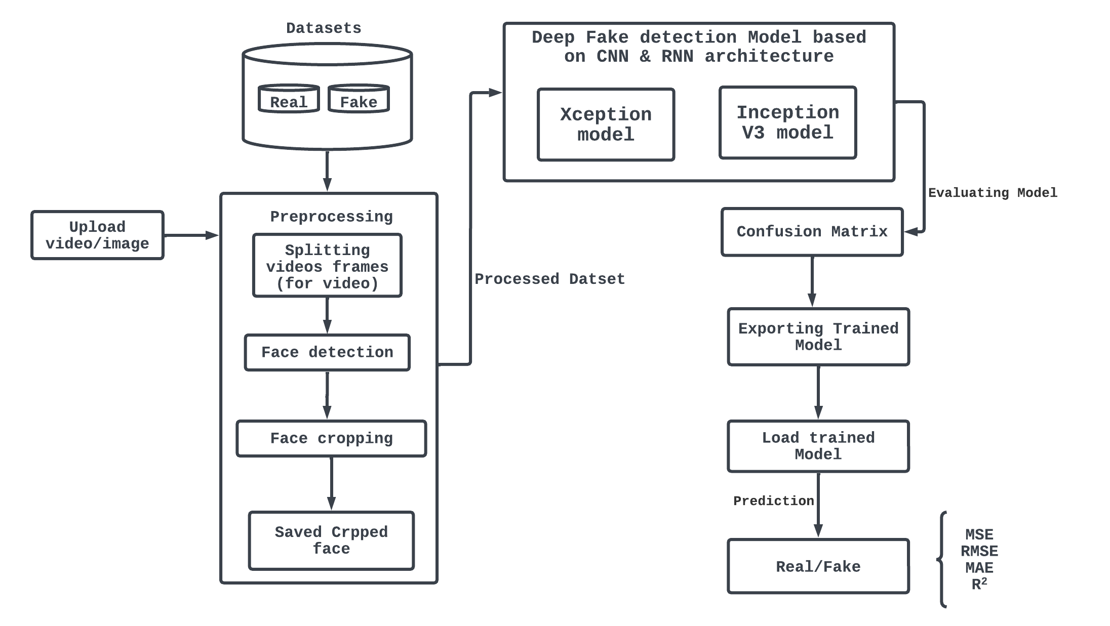
System Architecture
Computer Engineering Department
7

Slide 8
Methodology
Dataset Preparation :
- Utilized diverse datasets from YouTube, FaceForensics++, and DFDC.
- Custom dataset with 50% original and 50% deepfake videos.
- Training set (70%), validation set (10%), testing set (20%).
Custom CNN Model :
- Input layer (224x224x3).
- Convolutional layers with ReLU activation and max-pooling.
- Flatten layer for 1D vector, followed by fully connected layers with ReLU and dropout.
- Output layer for binary classification (fake or real).
Preprocessing Pipeline :
- Acquired video clips, extracted frames, and cropped faces.
- Rigorous preprocessing based on DFDC criteria.
- Utilized mean calculation for frame alignment.
- Processed initial frames for computational efficiency.
Computer Engineering Department
8

Slide 9
Methodology
Feature Extraction with InceptionV3 :
- Load video frames, crop, resize, and reorder channels.
- Use InceptionV3 for feature extraction and mask creation.
- Prepare videos with features, masks, and labels.
Alternative Approach - Xception Model :
- Pretrained Xception model fine-tuned for deepfake detection.
- Dataset converted to TensorFlow objects.
- Initialized model with frozen base and trained top layers.
- Fine-tuned model by unfreezing specific layers and adjusting learning rate.
Computer Engineering Department
9

Slide 10
Examples
A puppet-mastered deepfake to transfer source’s head movement and facial expressions on Putin’s face
Computer Engineering Department
10

Slide 11
Conclusion
In conclusion, our deepfake detection approach successfully leveraged diverse neural network architectures, including a custom CNN model and a fine-tuned Xception pretrained model. This integration enabled robust detection of manipulated images and subtle anomalies indicative of deepfake content. By analyzing just one second of video at 10 frames per second, our method achieved an accuracy increase from 60% to 80.8% through strategic training techniques. Implemented using TensorFlow and Keras libraries, our approach provides valuable insights for future research and development in deepfake detection.
Computer Engineering Department
11

Slide 12
References
[1]
Computer Engineering Department
12

